Slide 1


MicroProfile advantages for Monolithic applications
September 19, 2019
Eclipse MicroProfile Community

Slide 2
Overview
Monoliths
Microservices
Migration
Use Cases
Demo

Slide 3





JakartaEE - MicroProfile - Spring

Slide 4
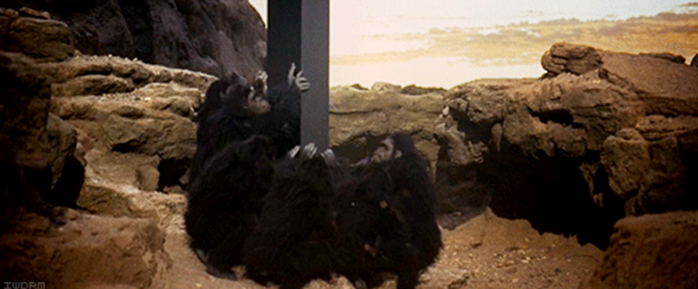
Are monoliths from the past?

Slide 5
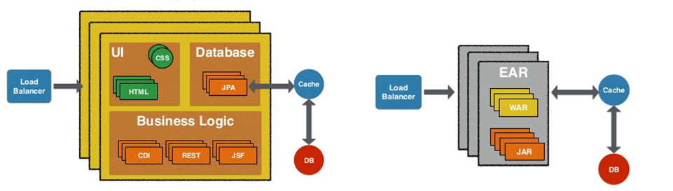
Java Monoliths
Easy to build, maintain, scale and deploy
images: @arungupta #devoxx

Slide 6

Microservices, the future?

Slide 7
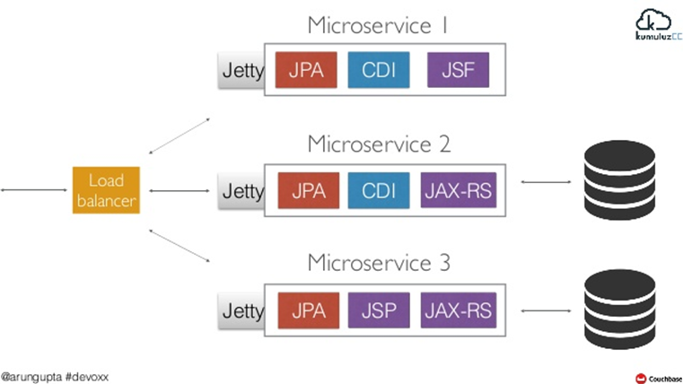
Java Microservices
images: @arungupta #devoxx

Slide 8
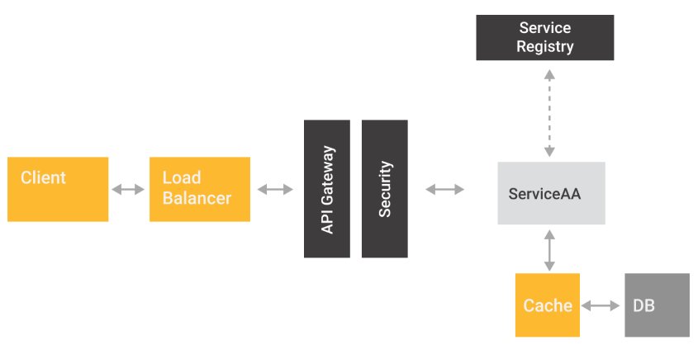
Microservices Architecture
Is by far more complex than a monolith, and needs a team to manage it
images: @tuxtor

Slide 9

Eclipse MicroProfile

Slide 10
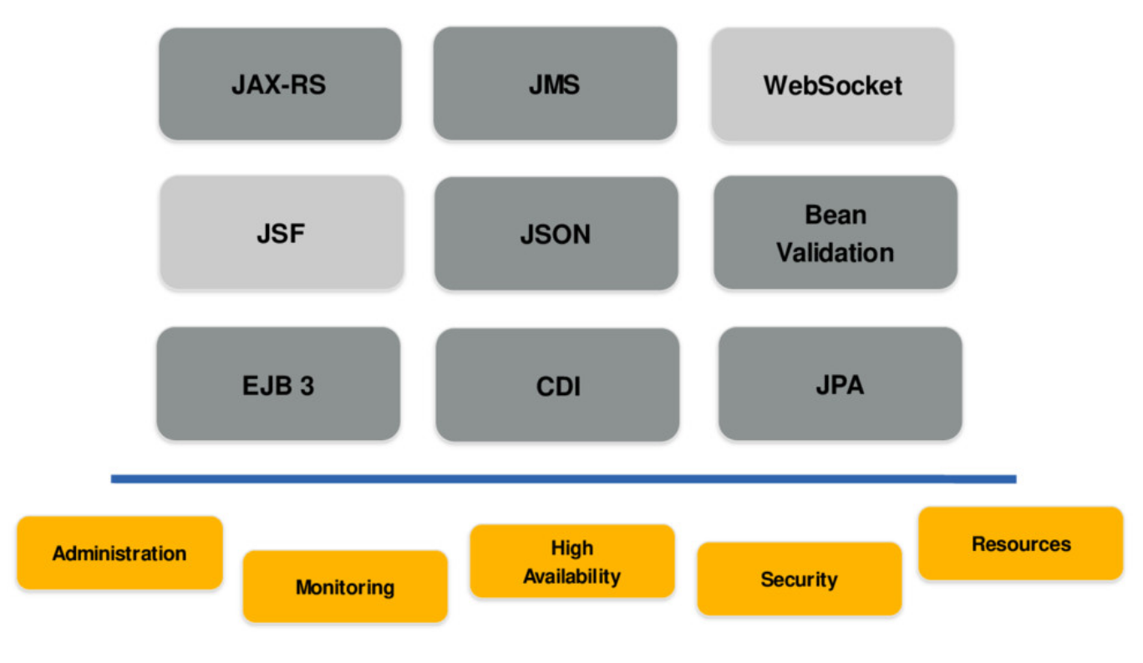
Microservices Characteristics
Can we archive some of this characteristics on our monoliths?
images: @reza_rahman

Slide 11
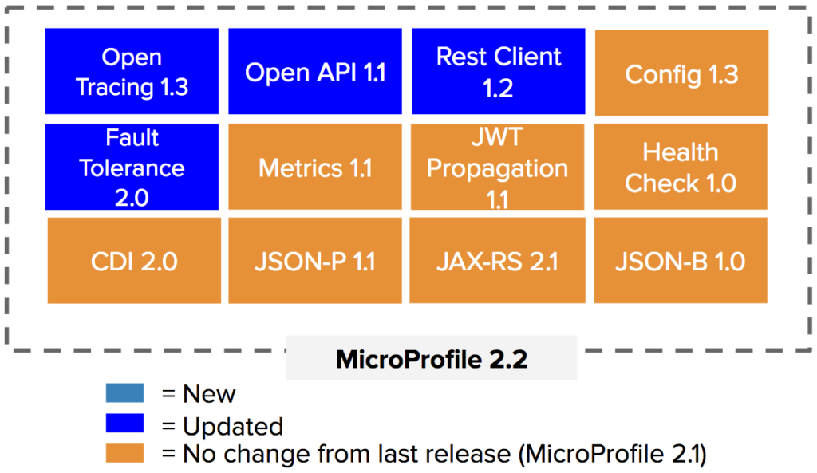
MicroProfile - API’s

Slide 12
MicroProfile Ecosystem
Libraries
SmallRye
Hammock
Apache Geronimo
Fujitsu Launcher
JEAS - Fat Jar, Uber Jar
Dropwizard
KumuluzEE
Helidon (Oracle)
Open Liberty (IBM)
Apache Meecrowave
Thorntail/Quarkus (Red Hat)
Payara Micro
Micro server - Thin War
Payara Micro
TomEE JAX-RS
Full server
Payara Application Server
JBoss Application Server / Wildfly
WebSphere Liberty (IBM)

Slide 13
Use Cases
Externalize your configuration
Document external API for third party integration
Fail with style
Monitor your monolith behavior

Slide 14









Víctor Orozco
JUG Leader in Guatemala
Java Champion
Oracle GroundBreaker
Duke’s Choice Award winner
JUG Leader in Guatemala
Java Developer
Duke’s Choice Award winner
Victor Orozco @tuxtor
Jorge Cajas @cajasmota

Slide 15
MicroProfile advantages for Monolithic applications

